Slide 1

The Influence of Peer Mentoring on Working Alliances and the Psychological/Social Well-being of Incarcerated Adults Jacob Eikenberry, MSW

Slide 2
Aims
To determine if a peer mentorship program reduces recidivism.
2. To investigate the effects of peer mentorship on several relevant psychological and social well-being indicators for the transitioning individual.
3. To investigate the role of peer mentoring on the formation of a working alliance between the mentor and the transitioning individual; one in which the transitioning individual experiences increased motivation and positive social support.

Slide 3
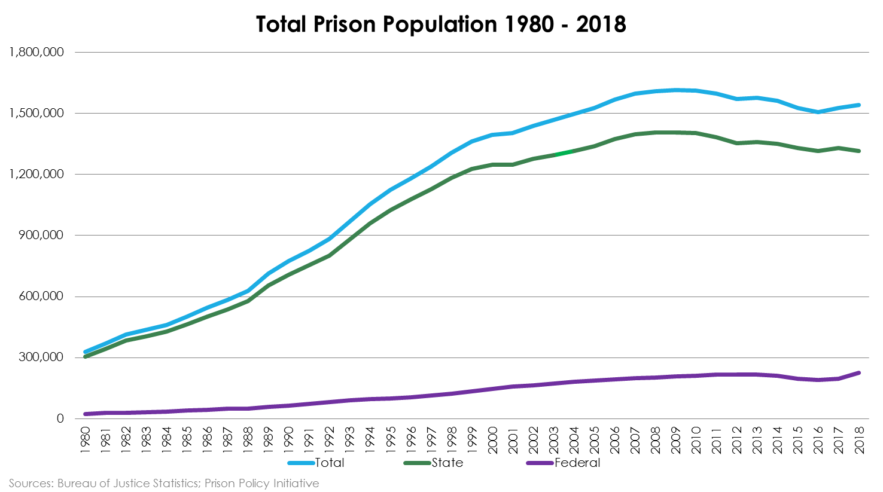
Background. “MASS Incarceration”
Notes:
Public Safety; cost of incarceration;

Slide 4
Disproportionality
Minority Populations
Impoverished Populations
Less Education
Mental Health and Substance Abuse Issues

Slide 5
Recidivism
68% of incarcerated individuals are rearrested within 3 years following release from prison. (Alper, Durose & Markman, 2018).

Slide 6
Reform Oriented Era
Pettus-Davis and Epperson
Smart on Crime
Several States have reduced their incarcerated Populations by more than 10%
Missouri is going the other direction

Slide 7
What we know about improving outcomes
Education
Cognitive Skills
Coping Skills
Employment
Substance Abuse and Mental Health Txment

Slide 8
Uptake of Intervention
Target ways for treatment components to be absorbed by the inmate population

Slide 9
Peer Mentoring: Innovation!
Story Time

Slide 10
Peer Mentoring
Mental illness and had been involved with the criminal justice system, having a shared lived experience sets a strong foundation for client engagement, and increasing hope and motivation in the path towards change (Barrenger, Hamovitch & Rothman, 2019)
Peer mentoring has been used for those with substance abuse issues and has been shown to increase motivation to change and days of sobriety, and reduce the exhibition of criminal behaviors.
Approximately 50% of those incarcerated have some form of mental illness and 70% of those have a co-occurring substance use disorder (Travis, Western & Redburn, 2014
For those returning from a period of incarceration, findings generally suggest social support from peers acts in a protective manner during the reentry process (Mowen & Boman, 2019).
“Wounded Healers”
Despite evidence, limited interventions have sought to use peer mentors in incarceration settings.
Barriers

Slide 11
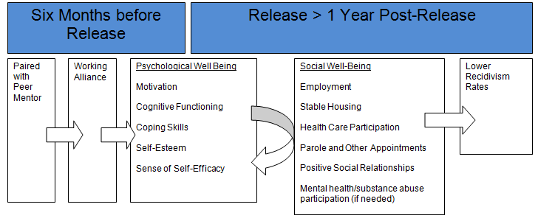
Conceptual Model

Slide 12
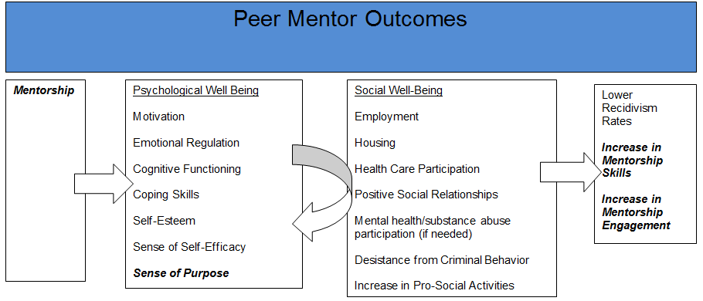
Conceptual Model Part II

Slide 13
Approach: Participants
MODOC Reentry Team
Parole Officers in Missouri
Mentors
Mentees (100 female and 100 male)

Slide 14
Training
Mentors must complete an online mentorship training program developed by Pathfinders.
After completion, mentors will have a two hour face to face session with the researcher and the MODOC re-entry team to finish training.
Due to regulations at MODOC, potential mentors will be required to submit to background checks and interviews with MODOC re-entry staff as desired.
Mentors will be accepted pending re-entry staff approval and be supervised by the researcher and the MODOC re-entry team. All mentors must have been without a criminal record and off parole for 2 years prior to serving as a mentor.
Mentors will also have supervisory meetings with the researcher on a monthly basis.

Slide 15
Mentoring
A one-on-one mentoring model will be used and mentors will be matched to participants based on age, gender, race, ethnicity, cultural background and location of release, to the extent possible
Participants will meet with their mentor three times (six months prior to re-entry, three months prior to re-entry, and at re-entry) for one hour sessions prior to release and monthly for up to one year post-release.
In the event that mentees are re-incarcerated, the mentor-mentee relationship will end.
Mentors will keep a list of locations, times, dates, etc. of all forms of contact with participants for researcher review.

Slide 16
Methodology
Participants become eligible for the intervention at six months prior to release and when assigned a re-entry team.
Opt-in to the study and fill out demographic questionnaires before random assignment to either a control or intervention group
The working alliance inventory-short-revised offender with peer mentor version, will be distributed to all participants at four times; 3 months prior to release, at release, 6 months after release, and one year after release.
Those participants in the control group will use the working alliance inventory in relation to their alliance with their assigned parole officer. Those participants in the intervention group will use the working alliance inventory in relation to their peer mentors and their parole officers.
All participants will complete psychological and social well-being surveys and these will be collected at five time periods.
All social well-being surveys will be collected at four time periods

Slide 17
Materials
Demographic Questionnaire; 32 items created by the researcher
Working Alliance Inventory-Short-Revised Offender Version (WAISR): This 12 item self-report questionnaire uses a 7-point Likert Scale ranging from strongly disagree to strongly agree. Total scores range from 12 (low working alliance) to 84 (high working alliance). The WAISR contains three subscales: Goals (internal consistency; α = .85 - .87), Tasks (α = .85 - .87), and Bond (α = .85 - .90) (Hatcher & Gillaspy, 2006).
Modified from the working alliance inventory- long form (used to measure therapeutic alliance between therapist and clients) for offender use wherein the therapists were probation and parole officers (Tatman & Love, 2010).
For the purpose of this study, the 12 item survey will be modified so as to replace probation and parole officers with peer mentors.

Slide 18
Materials Cont.
Self-Improvement Orientation Scheme-Self Report (SOS-SR): The SOS-SR is a 72-item self-report instrument designed to measure broad behavior change concepts including 12 subscales; all scored using a five point Likert scale (Simourd & Olver, 2011).
1. Self-Efficacy/Willpower: This eight item subscale measures a participant’s confidence in achieving goals.
2. Cognitive Perspective: This six item subscale measures the mental orientation of respondents.
3. Motivation Level: This four item subscale measures the participants drive to make changes in their life.
4. Coping Skills: This five item subscale measures the participants ability to problem solve and cope with problems.
5. Self Esteem: This four item subscale measures how participants view themselves.

Slide 19
Materials Cont.
Several social-well-being items will be included in one self-report instrument created by the researcher.
Employment will be measured dichotomously (yes/no), as a continuous variable in number of hours per week and number of days at their respective job, and several other demographic variables will be tracked such as type of employment, compensation amounts, and number of job interviews completed.
Housing will be measured dichotomously (yes/no), across a range of choices (e.g. stably housed, temporarily housed, living with a relative, etc.), and the number of days participants were housed in their respective situations.
Participants will report the number of scheduled parole and other mandatory appointments and if they were in attendance.
Participants will be tracked for the entire period of supervision or until re-arrest. In collaboration with participant’s parole officer; any rearrests, convictions, and/or technical violations of parole will be tracked.

Slide 20
Compensation
All participants will receive financial compensation in the amount of ten dollars for each of the time intervals in which they fill out all questionnaires as a means of keeping clients invested. (10,000 dollars )
Mentors will receive 20 dollars for each of the sessions that they are able to complete with clients. A total of 15 one-hour sessions is possible for each of the 100 intervention participants (30,000 dollars)
However, when factoring in a conservative estimate of a one-year recidivism rate (from 56% to 30%), the total amount needed is 21,000 dollars.
31,000 dollars

Slide 21
Limitations
First, if recidivism is not lowered by the proposed intervention, the other aims of the study may not matter as much.
For example, does it matter if a working alliance is formed or even if social and psychological well-being is improved if the offender ultimately recidivates?
The author of this study suggests that this can provide pertinent information regarding the re-entry process..
One other potential limitation is dealing with attrition as this population tends to recidivate at high rates upon release, especially within the first year.

Slide 22
Questions?
Answers?
Suggestions?

